Slide 1
Scenarios

Slide 2

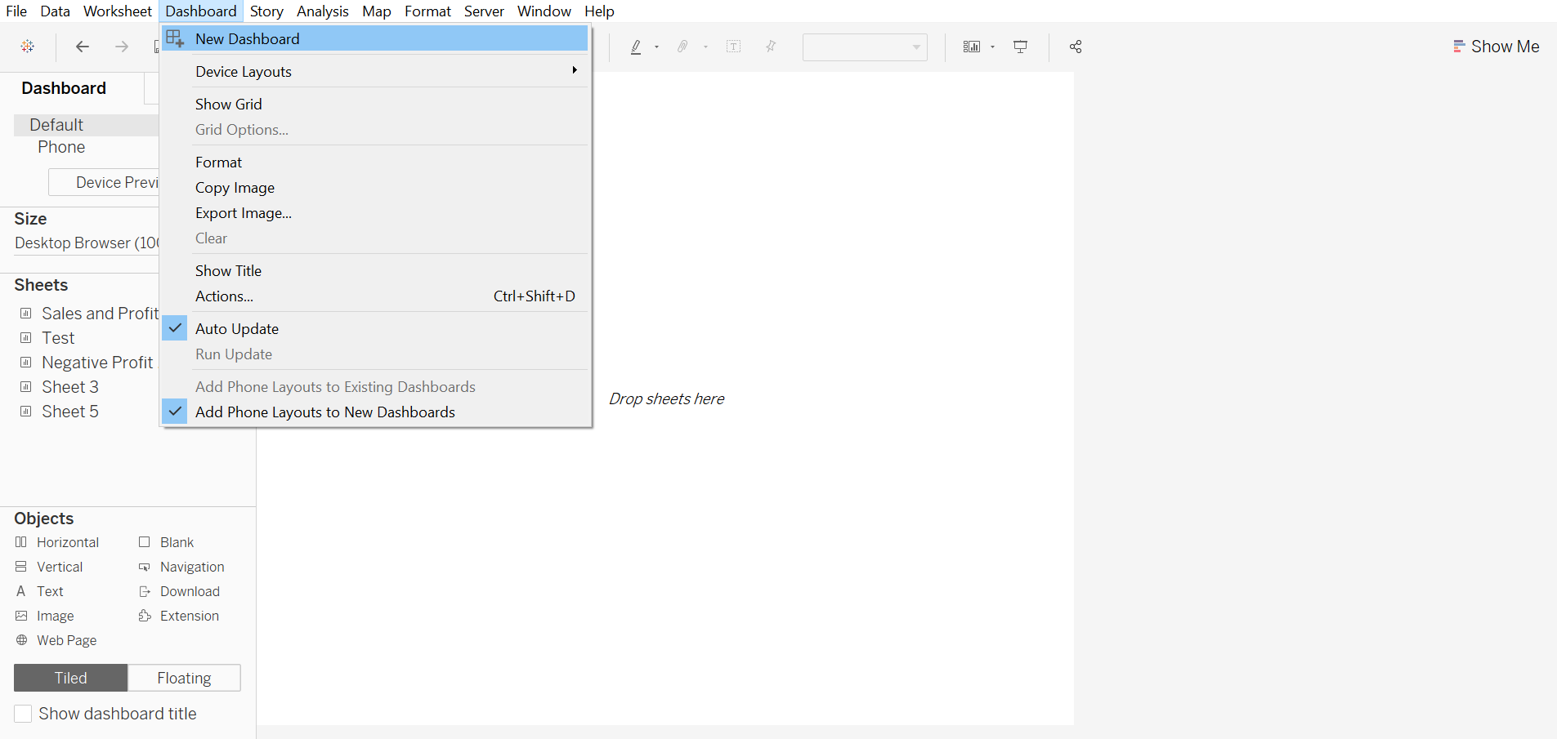
Build Interactive dashboard to show some insights

Slide 3
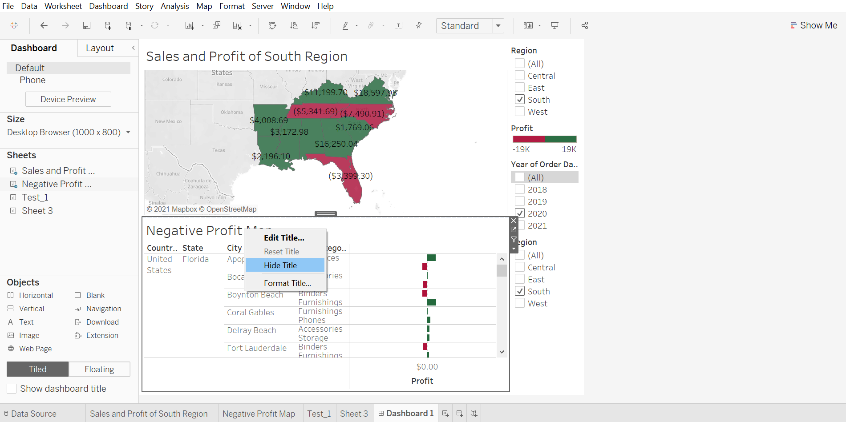
Arrange your dashboard

Slide 4
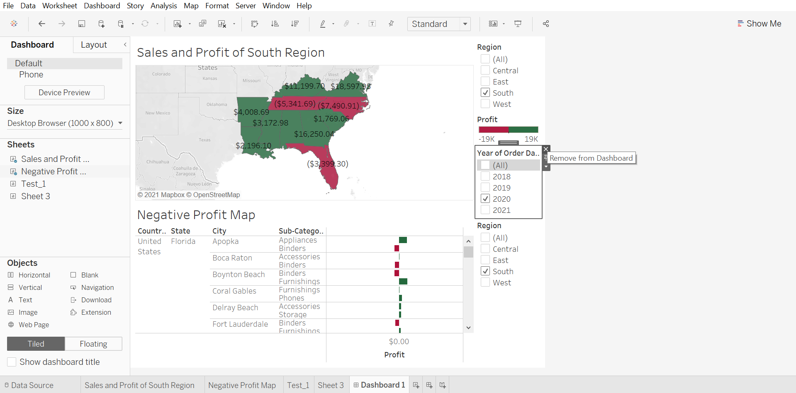
Remove filter options to vacate the space

Slide 5
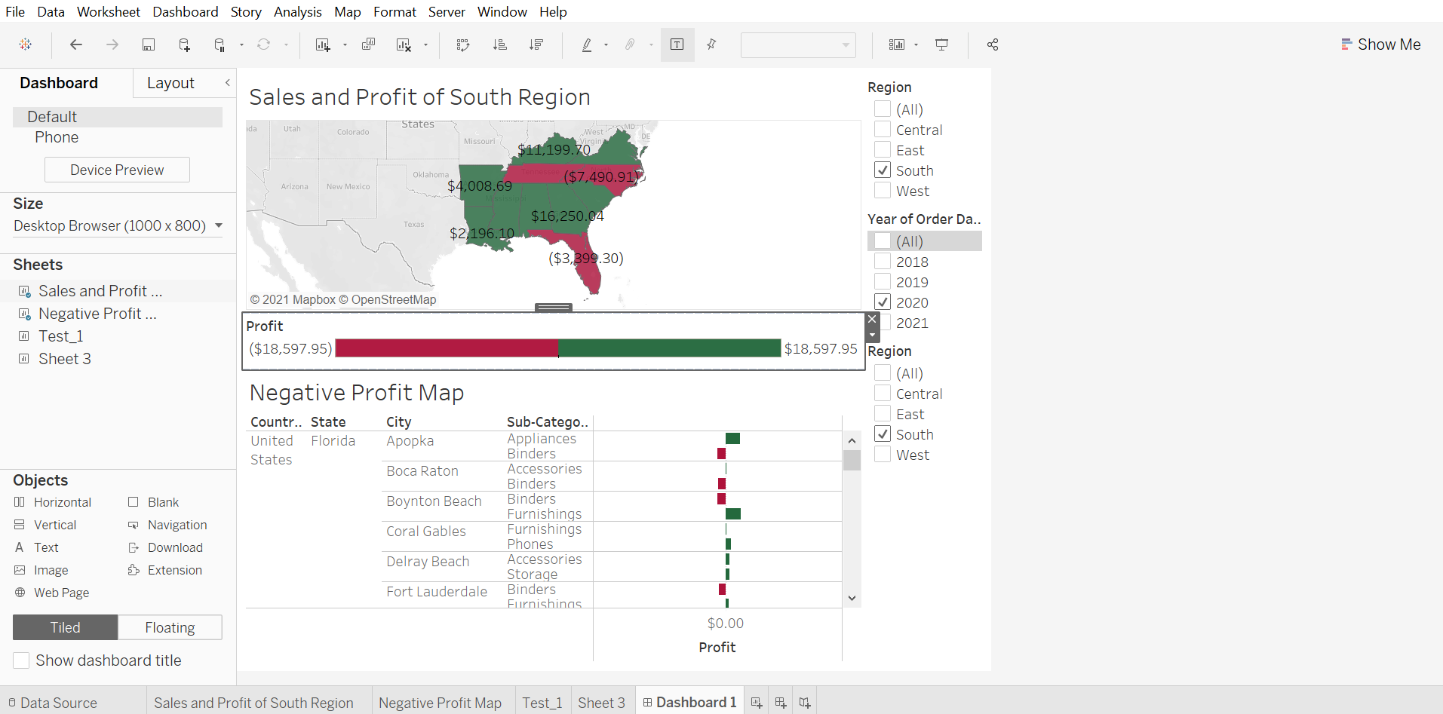
Select Profit color legend and drag it to Sales and Profit of South Region

Slide 6
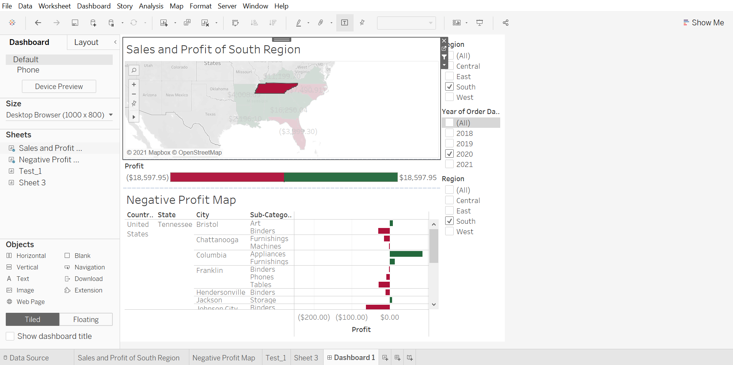
One by one click all the states in the profit map having negative profit and check both profit and sales of each state.

Slide 7
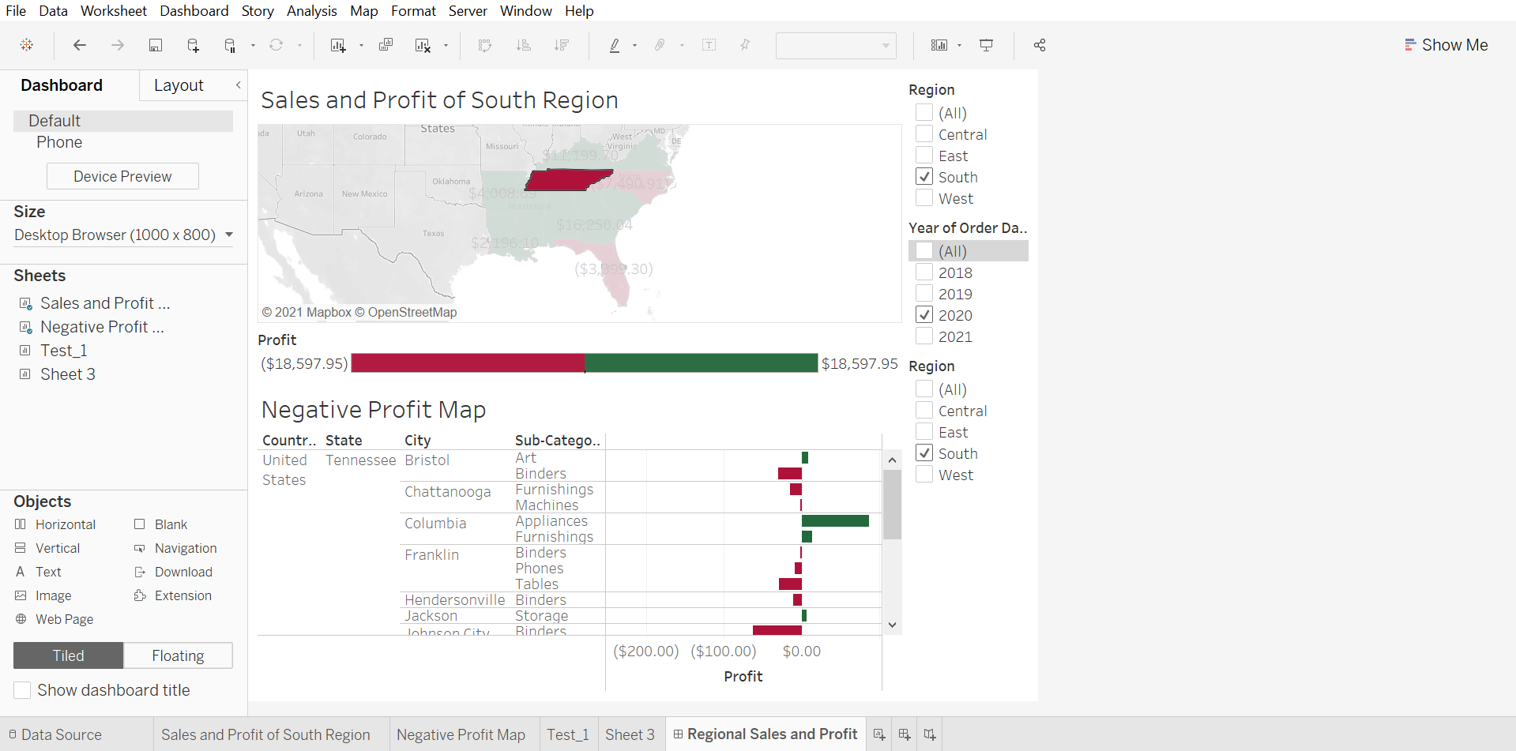
Rename your dashboard and save as Regional Sales and Profit.

